Slide 1
APPLIED DATA SCIENCE CAPSTONE PROJECT
This presentation contains all visualizations derived from the Ipython notebook that was uploaded on Github.

Slide 2
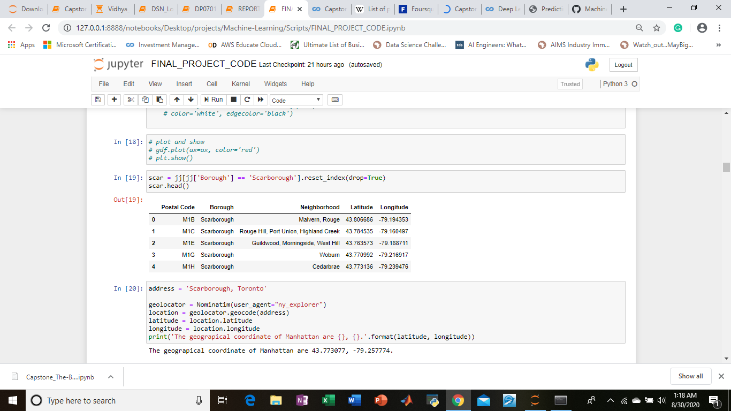
This is the dataset that was derived after scraping wikipedia and other manipulations

Slide 3
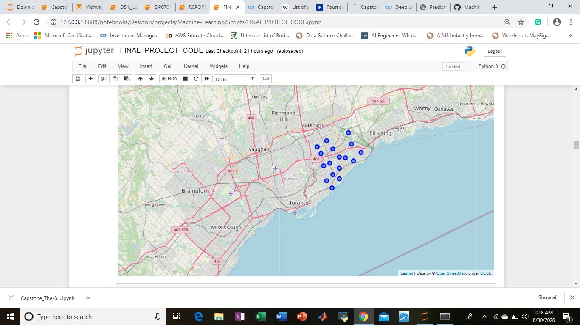
This is the Scarborough neighborhood

Slide 4
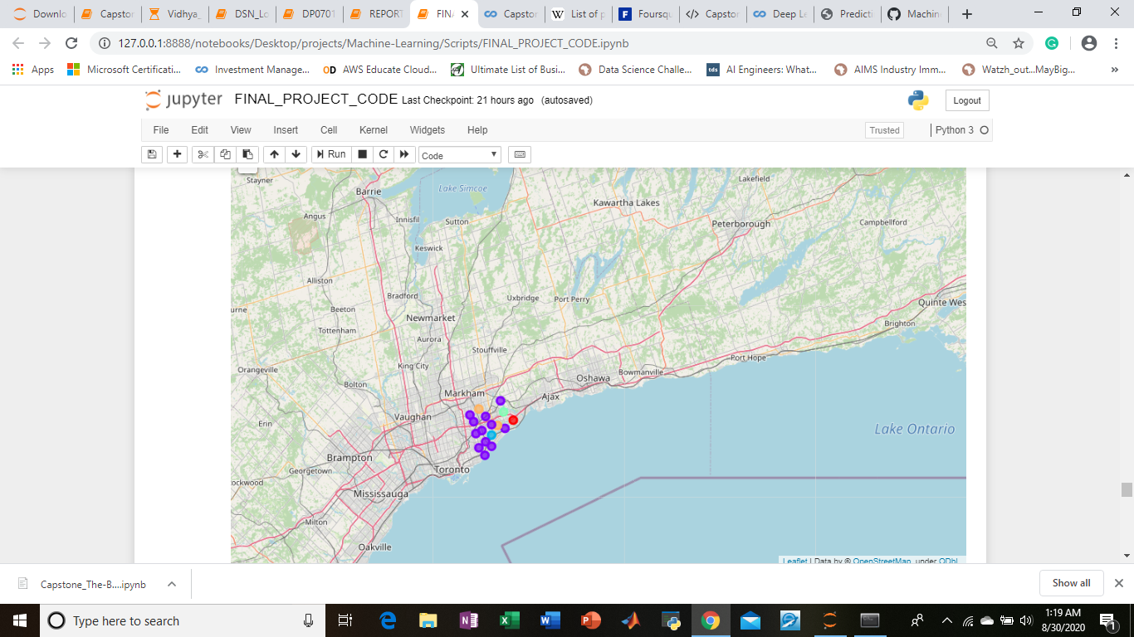
This is the result of our cluster.

Slide 5
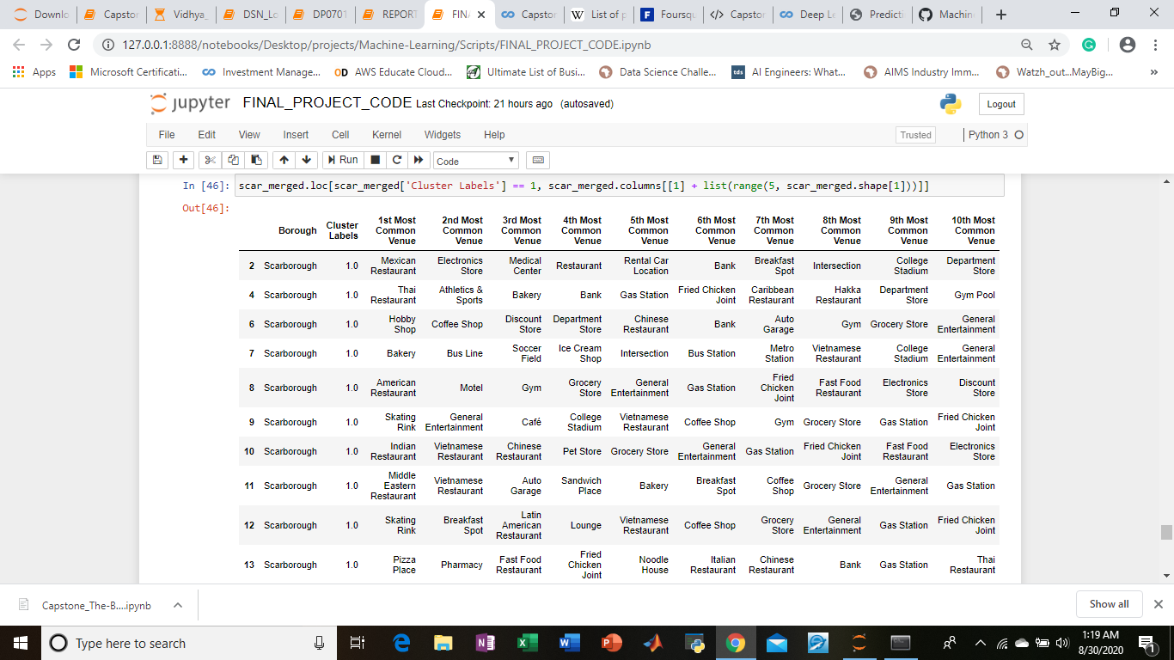
As we can clearly see in cluster 2, these are the places of interest.

Slide 6
Thank You.

